Slide 1
STEGANOGRAPHY- hiding information in the image
CAPSTONE PROJECT
Presented By: S Vignesh
Student Name : S Vignesh
College Name & Department : Adhiyamaan College of Engineering(Autonomous), Department of Information Technology

Slide 2
OUTLINE
Problem Statement
Technology used
Algorithm & Deployment
Result
Conclusion
Future scope
Reference

Slide 3
Problem Statement
Traditional encryption techniques are frequently vulnerable to interception and decryption by unwanted parties, despite the growing need for secure data transfer.
Traditional data protection methods could cause suspicion, which leaves them open to attacks.
To safely integrate sensitive information in digital media without compromising its perceptual quality, a discreet, reliable, and effective method is required.
To enable safe and undetected transmission of sensitive data, the solution will concentrate on improving embedding efficiency, resilience to attacks, and preserving the carrier image's visual integrity.
The goal of this project is to create a **Secure Data Hiding in Images Using Steganography** system that will guarantee that private information is hidden inside pictures while remaining highly imperceptible and resistant to steganalysis.

Slide 4
system development approach
Libraries Used in the Program:
OpenCV (cv2) – Used for reading, modifying, and saving images.
OS (Used to execute system commands (e.g., opening the encrypted image).
String (Provides character manipulation utilities (though not used explicitly).
Platform Compatibility:
The program is designed for Windows (due to os.system("start encryptedImage.jpg") for opening the image).
It can run on Linux/macOS with minor
Requires Python 3.x with OpenCV (cv2) installed (pip install opencv-python).

Slide 5
Algorithm & deployment
Read the cover image.
the secret message to binary.
Replace the least significant bit (LSB) of image pixels with message bits.
Repeat until all message bits are hidden.
Save the new image as the stego image.
Decode by extracting LSBs and converting back to the message.
DEPLOYMENT
Install Python and required libraries (Pillow, numpy).
Write encode.py to hide the secret message.
Write decode.py to retrieve the secret message.
Test the scripts with a sample image and message.
(Optional) Wrap into a CLI or web app for easy use.
Deploy the app on a server or cloud platform

Slide 6
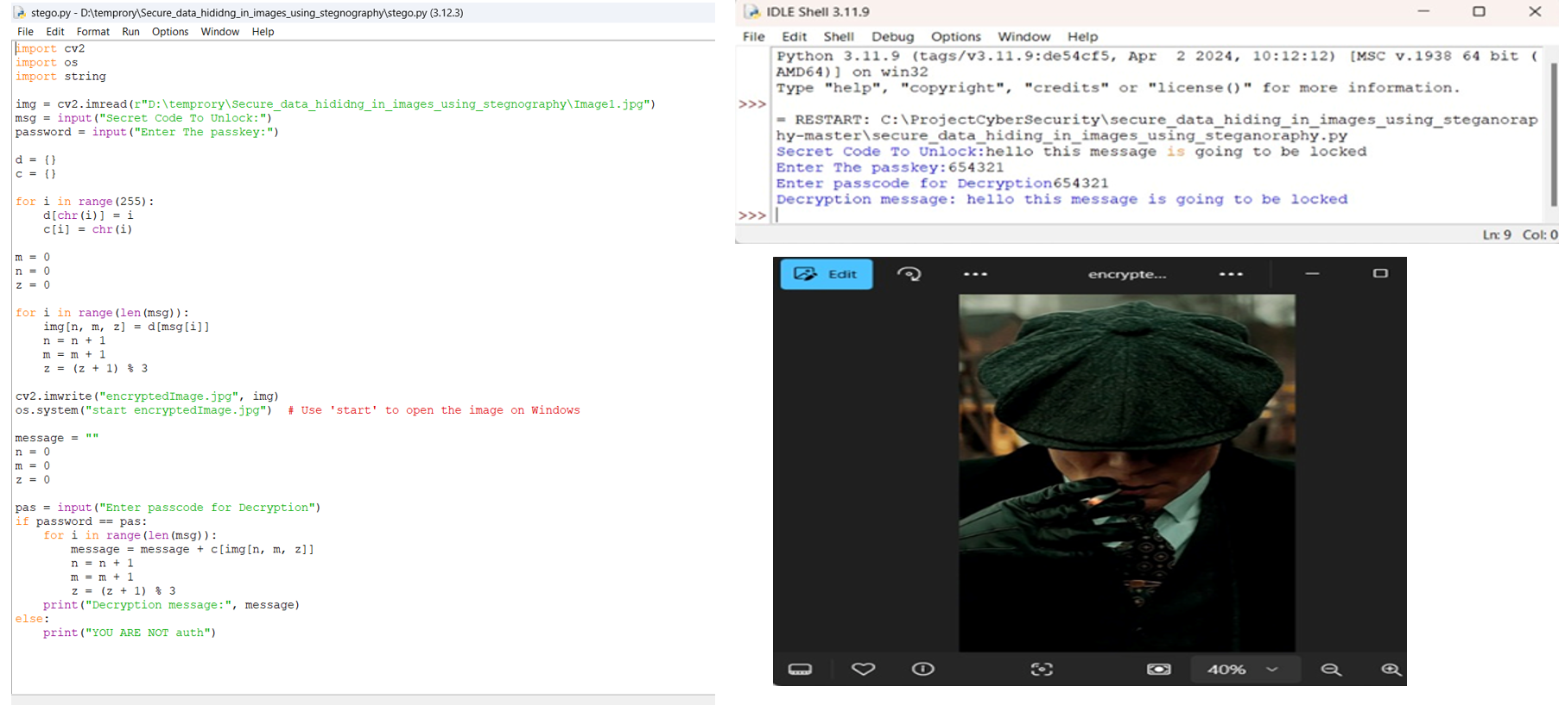
Results
Github :https://github.com/SivaVignesh/steganogarphy-.git

Slide 7
Conclusion
The Safe Information Concealed in Pictures The difficulty of secret data transfer is well addressed by the Steganography project, which embeds private data into digital images while preserving their aesthetic integrity. While traditional encryption techniques can draw attention and be intercepted, this technology guarantees that private communications are invisible to unauthorized parties. The solution improves security and stops unwanted access by utilizing passkey-protected decryption and direct pixel manipulation. Minimal picture distortion is guaranteed by the use of a lightweight yet powerfuls teganographic approach, which makes it an ideal solution for secure communication in a variety of fields, such as cybersecurity, law enforcement, and corporate data protection.

Slide 8
FutURE scope
My Future Scope in Cyber Security is to learn about to protect myself from cyber threats and protect my identity

Slide 9
rrferences
https://www.slideshare.net/jsdcuraj/project-ppt-21359799?utm_source=chatgpt.comhttps://www.slideshare.net/jsdcuraj/project-ppt-21359799?utm_source=chatgpt.com
https://www.slideshare.net/MohamedTalaat9/data-hiding-steganography?utm_source=chatgpt.com

Slide 10
THANK YOU

